Slide 1
Why Unsupervised?
RX 319
Introduction to Healthcare Analytics

Slide 2
Learning Objectives
Describe the goal of unsupervised learning.
List unsupervised learning methods.
Interpret a dendrogram.
2

Slide 3
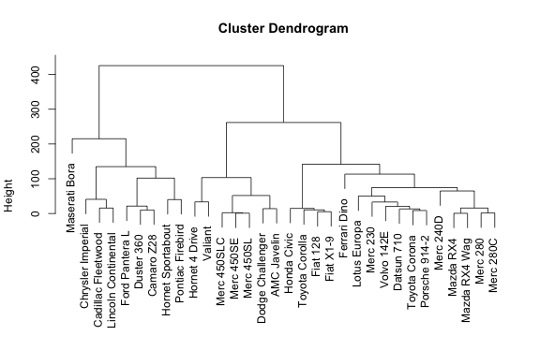
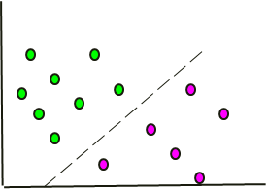
Types of Machine Learning
Unsupervised Analysis
Supervised Analysis
Which people/things are similar to each other?
Can we predict a result based on features?
Why?
Identify subgroups
Identify outliers
Feature 2
Feature 1
3

Slide 4
Reading a Dendrogram
Things on the same “branch” are more similar to each other
Two things are connected further up = More different
4

Slide 5

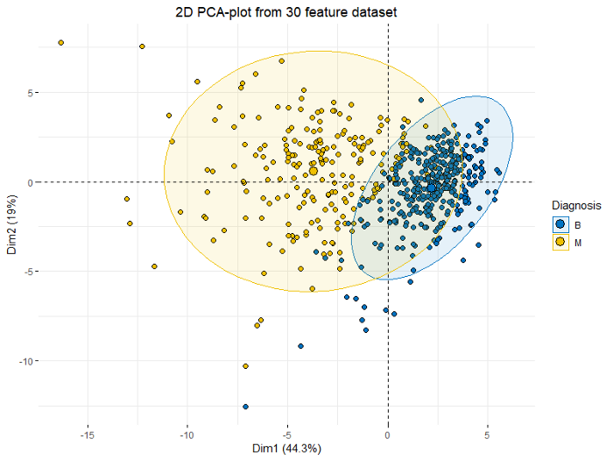
Dimension Reduction
One method is Principal Component Analysis (PCA)
PCA lets you reduce the number of dimensions in your data, making it easier to see similarities
Example
Going from 3D → 2D
Retaining most of the information, but making it simpler
What about 20,000D → 2D ?
5

